Slide 1
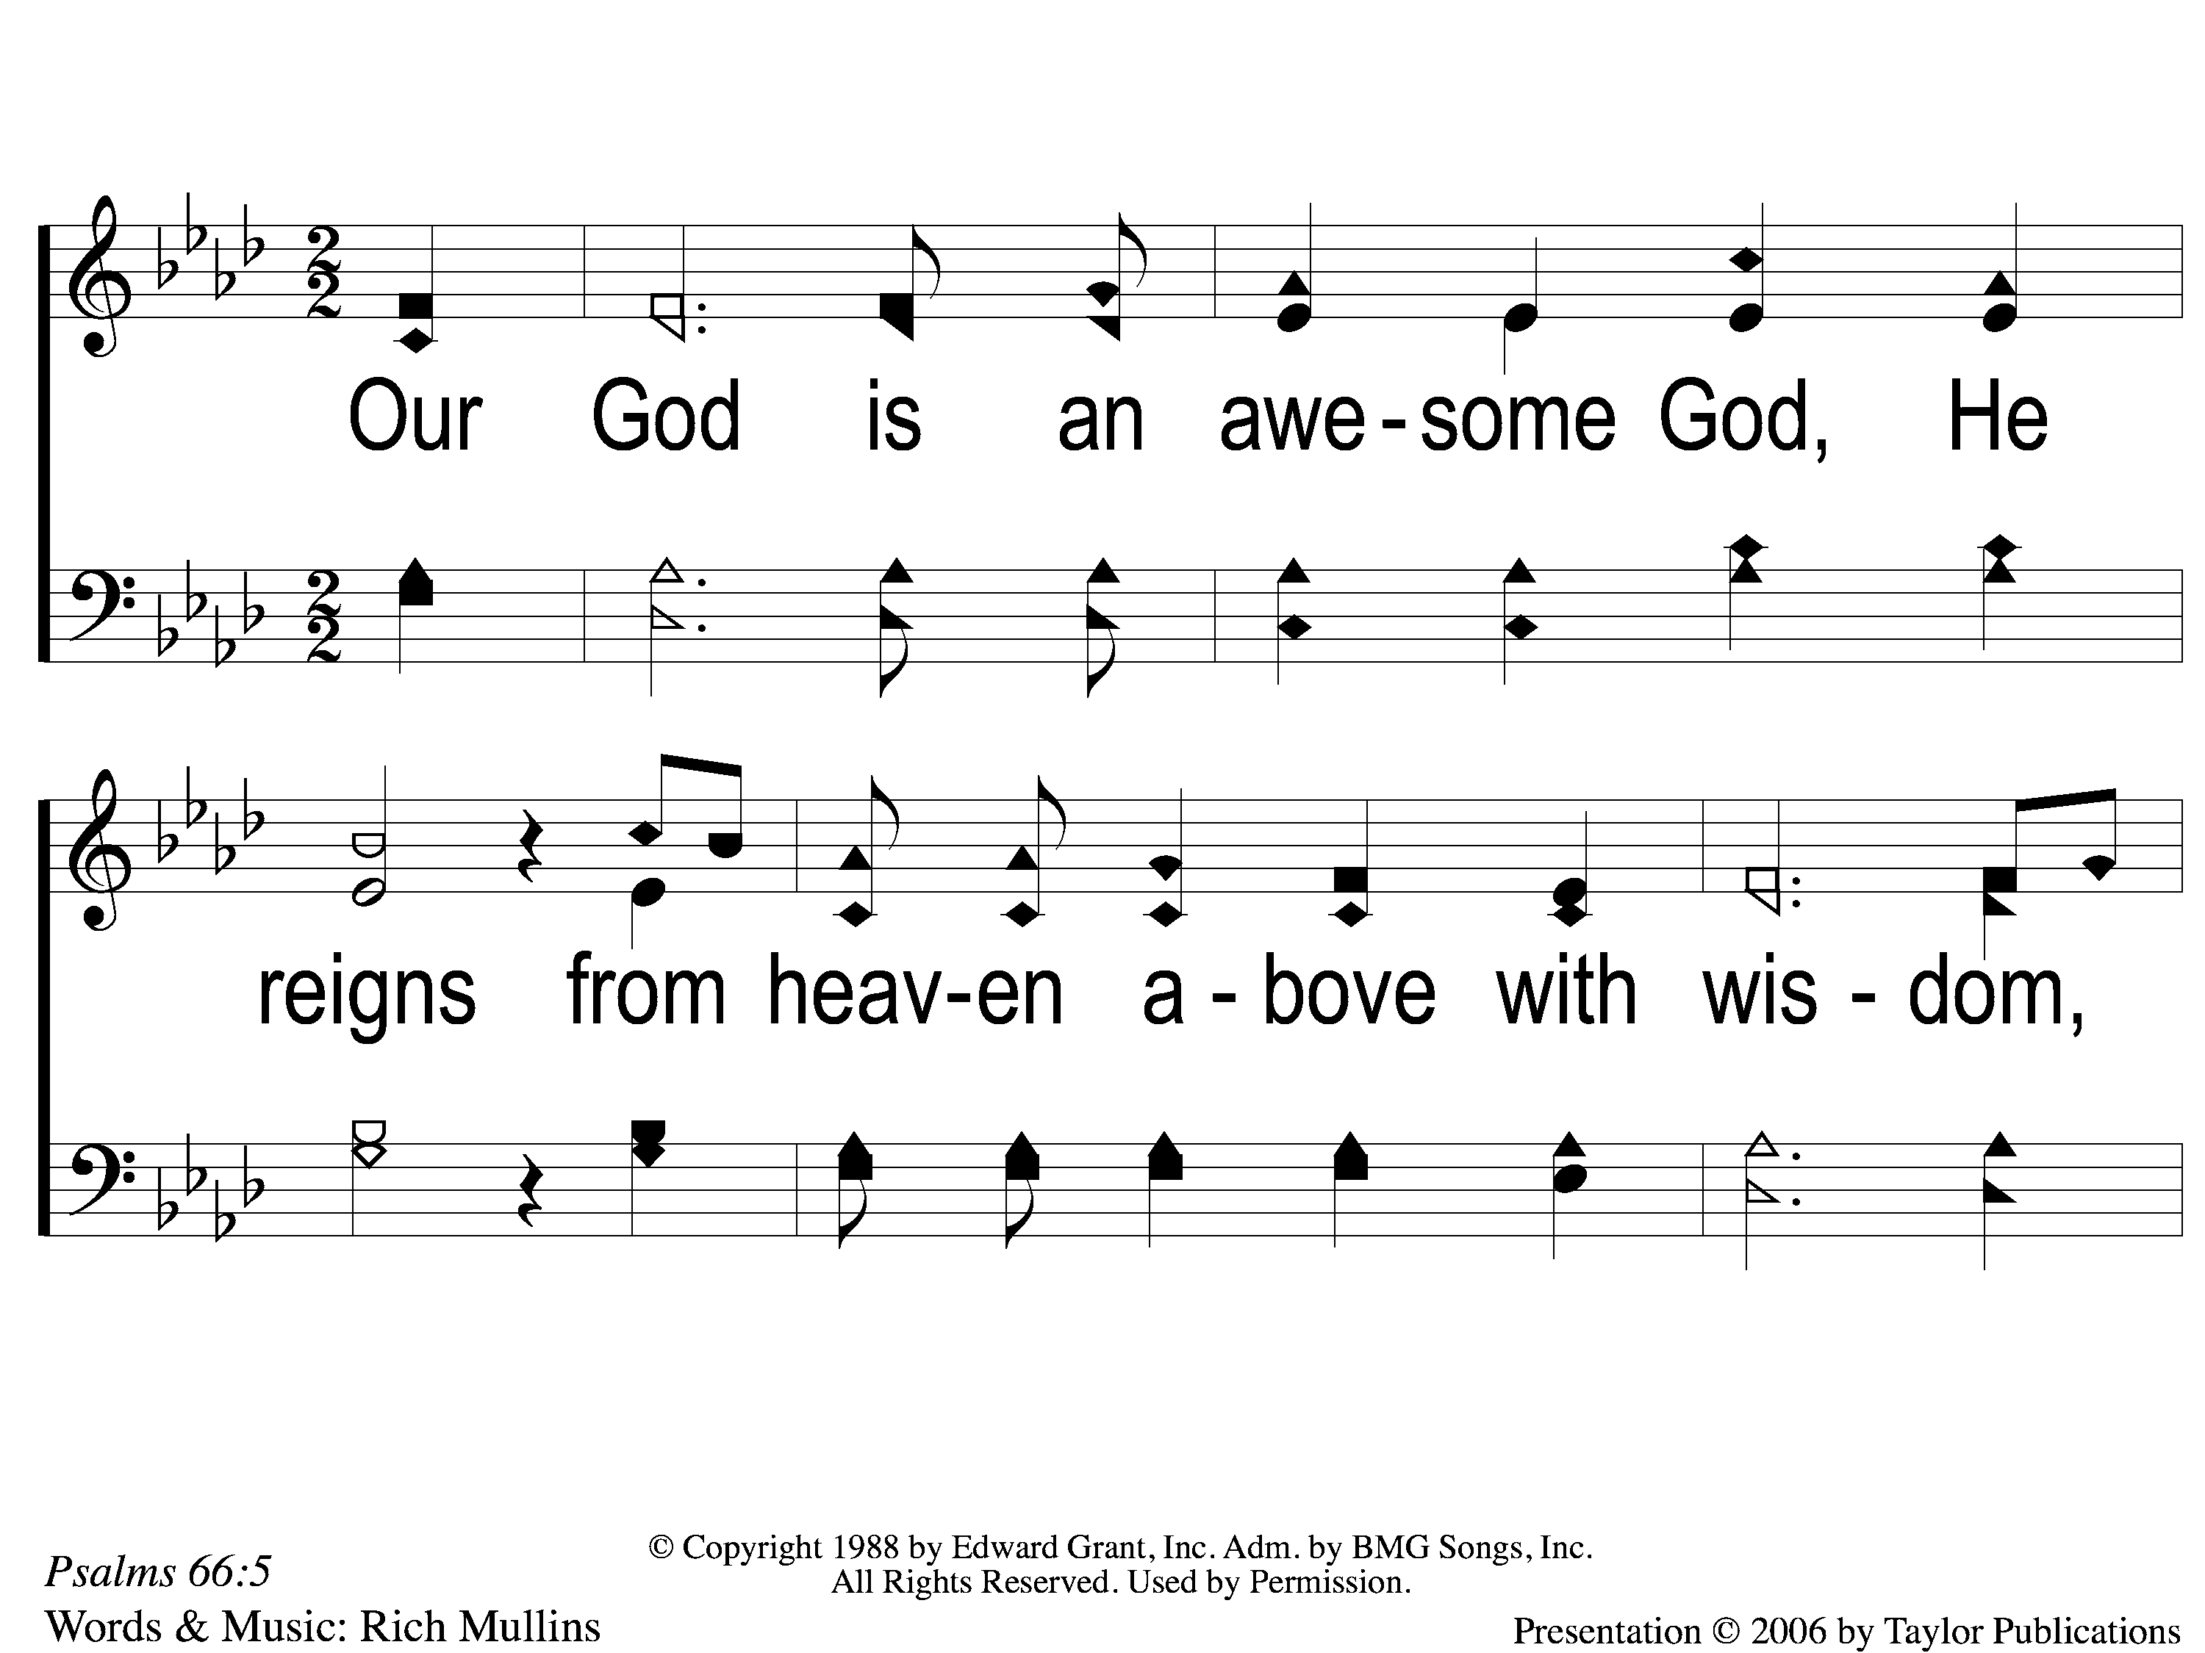
1 Awesome God
Awesome God
38

Slide 2
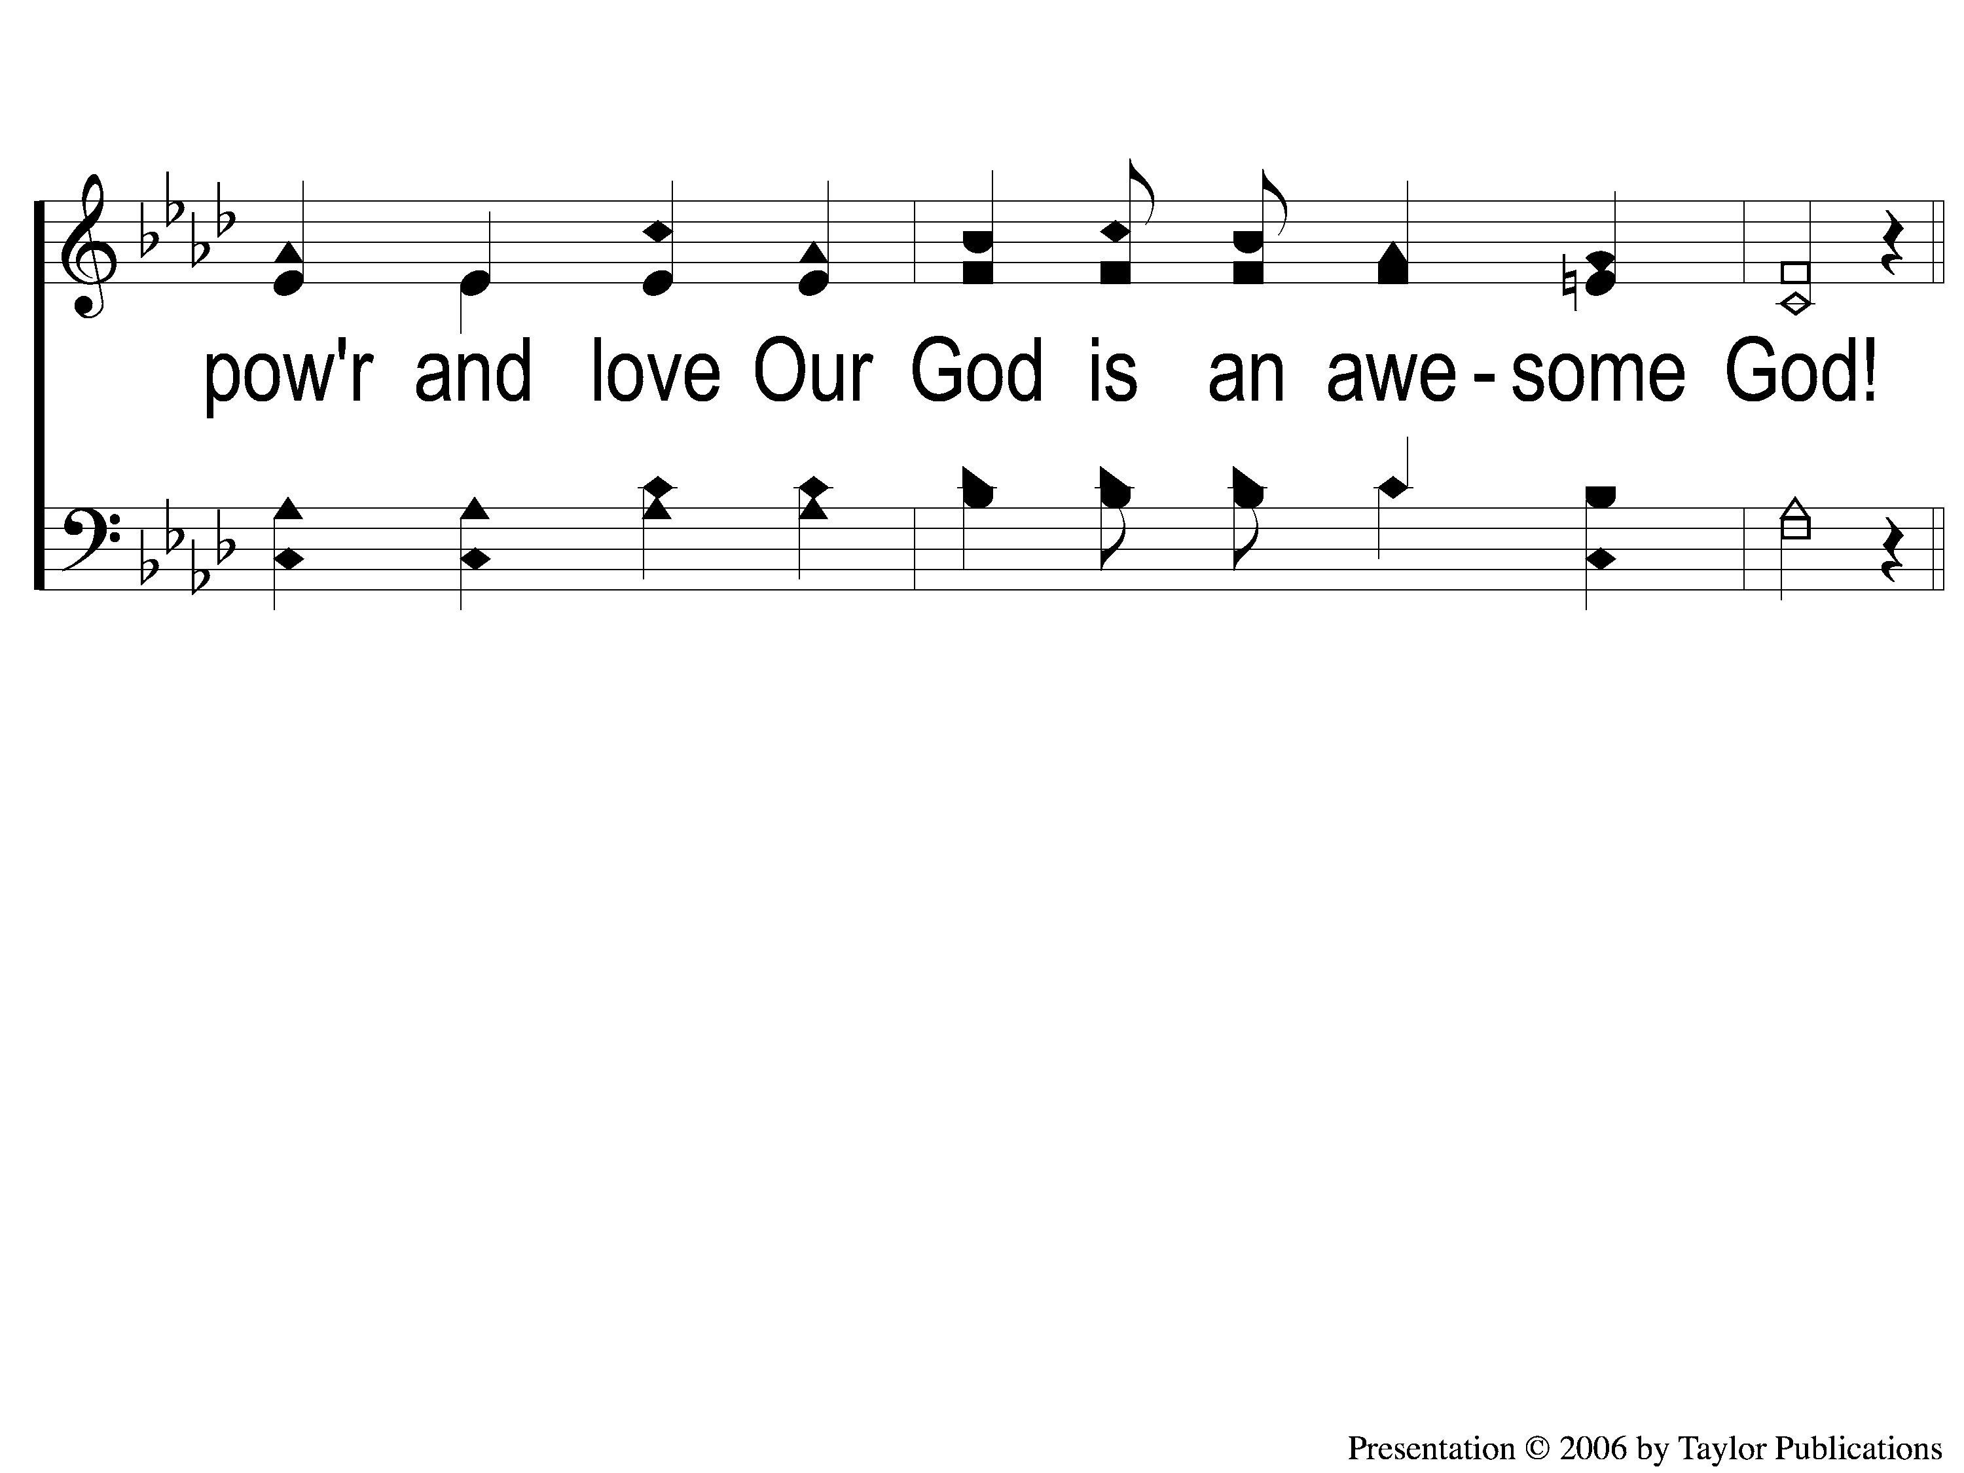
2 Awesome God
Awesome God
38

Slide 3
1 Awesome God
Awesome God
38

Slide 4
2 Awesome God
Awesome God
38

Slide 5
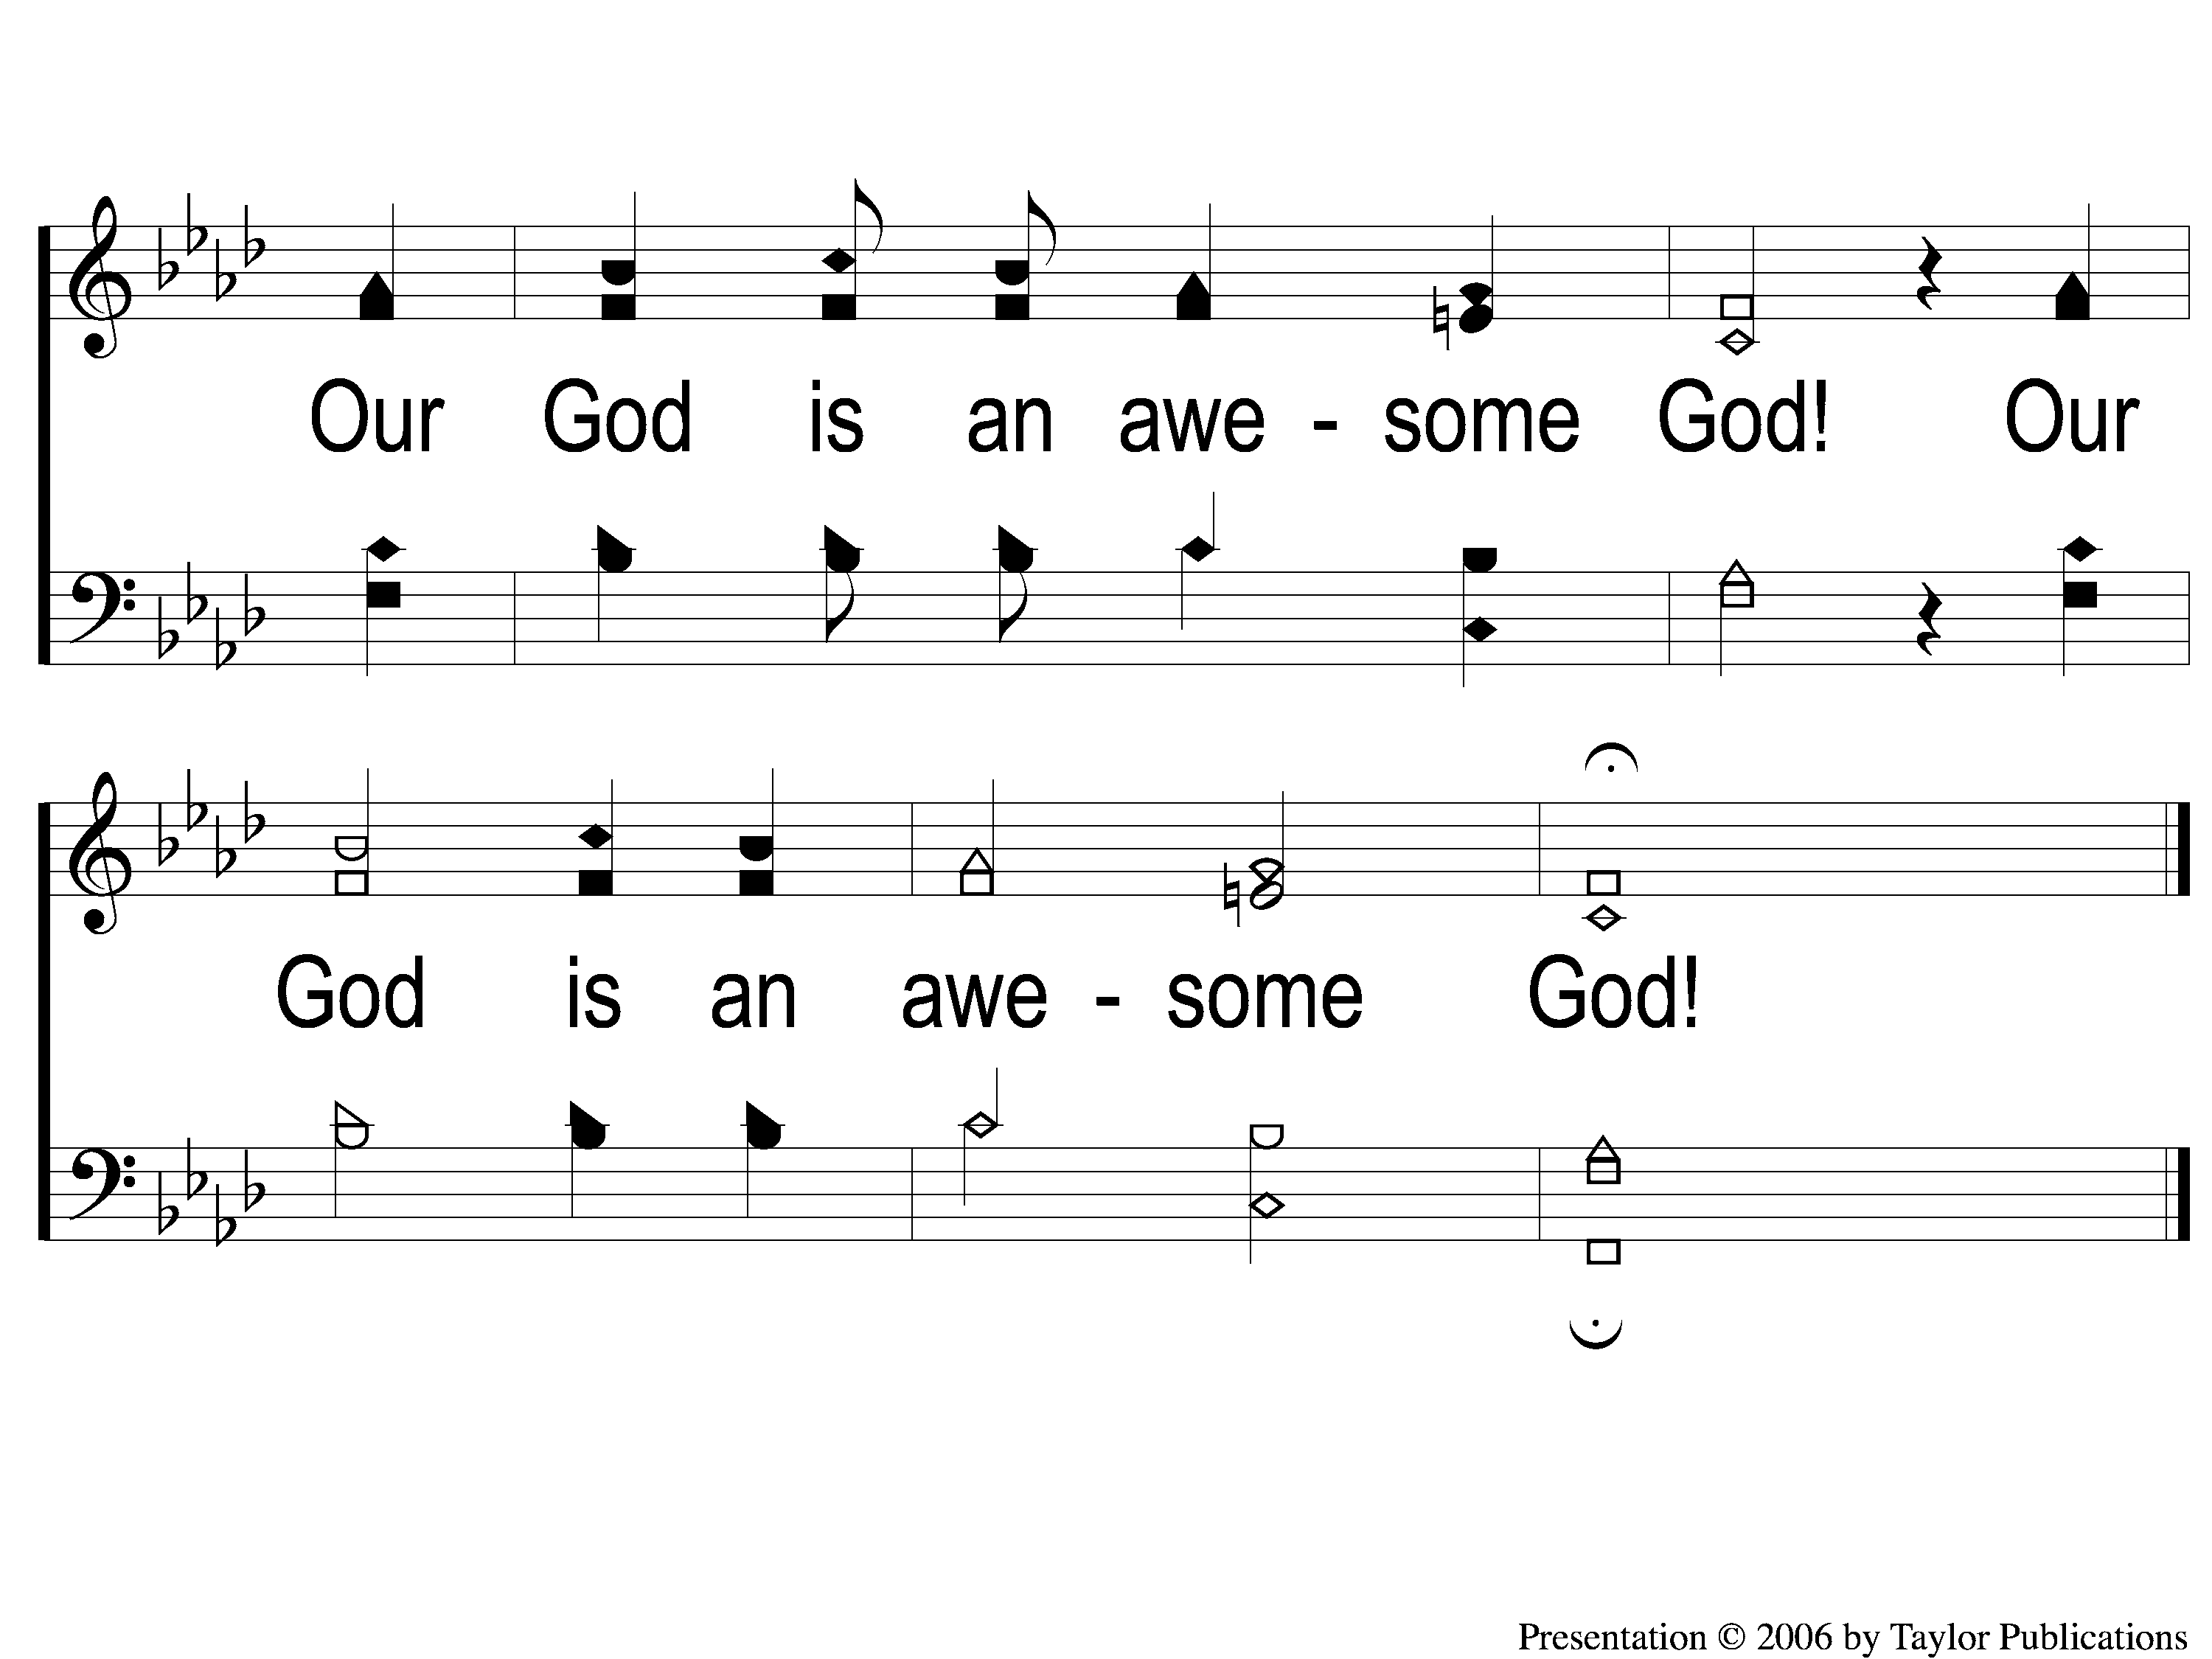
3-end Awesome God
Awesome God
38

